Slide 1
Topological Sorting
Nahian Salsabil

Slide 2
DAG -> Directed Acyclic Graph
a directed acyclic graph (DAG) is a directed graph with no directed cycles

Slide 3
Topological Sort
A topological sort of a DAG G = (V,E) is a linear ordering of all its vertices such that if G contains an edge (u,v) , then u appears before in the ordering. (If the graph contains a cycle, then no linear ordering is possible.)
Basically sorting occurs based on the decrement of the finishing time of each vertex.

Slide 4
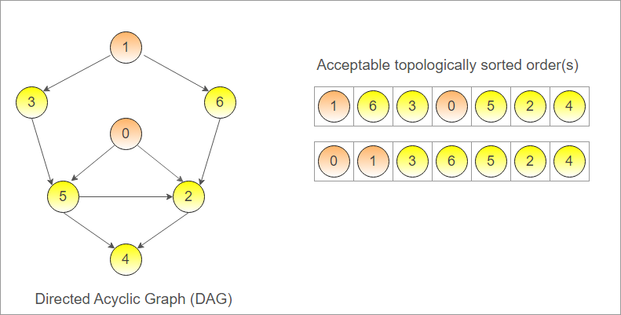
Topological Sort

Slide 5
Topological Sort
Unacceptable topologically sorted order:
1 6 3 2 5 0 4
As 0 should come before 2

Slide 6
Topological Sort
Can be done using both BFS and DFS
Usually DFS is preferred [self study: link1, link2]
Algorithm:
Call DFS(G) to calculate finishing time for each vertex.
Upon finishing a vertex, push the vertex in a stack.
Print the stack and we get the topological sort.

Slide 7
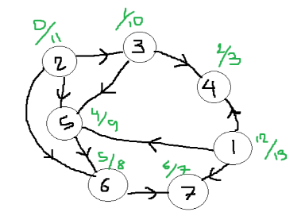
Topological Sort
After calling DFS(G)

Slide 8

Topological Sort
After calling DFS(G)

Slide 9
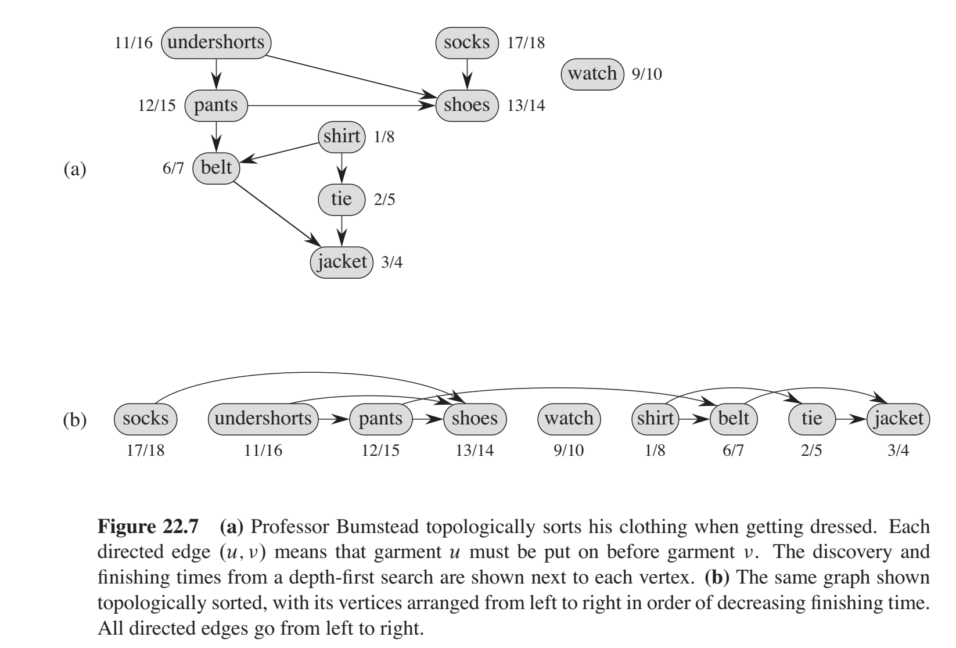
Topological Sort Example

Slide 10
Courses | Prerequisites
Python
OOP | Python
DS | OOP
Algo | DS
Database | OOP
HPDS | Database
Security | Networking
ML | Python, Linear Algebra
Linear Algebra
Graphics | Python, Linear Algebra
Graph | Algo
Networking | Python

Slide 11
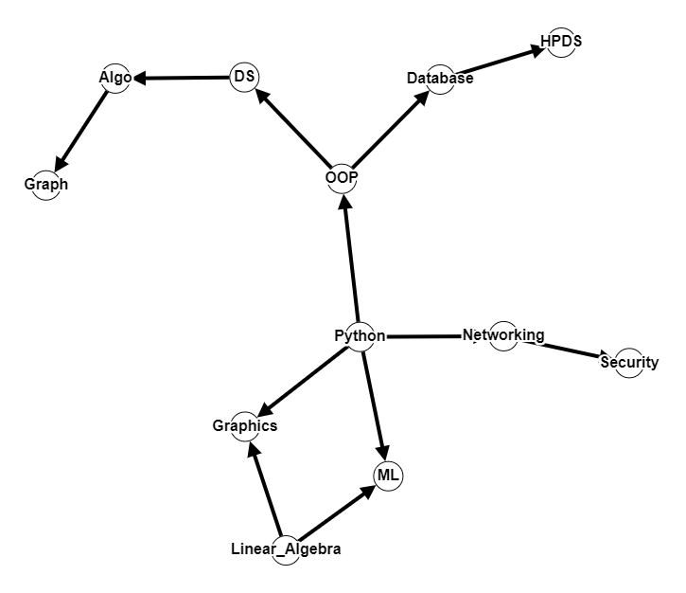
Step 1:
Create Graph

Slide 12
Step 1:
Run DFS
1

Slide 13
2
1

Slide 14
3
2
1

Slide 15
4
3
2
1

Slide 16
4
3
5
2
1

Slide 17
4
3
5/6
2
1
Graph

Slide 18
4/7
3
5/6
2
1
Algo
Graph

Slide 19
4/7
3/8
5/6
2
1
DS
Algo
Graph

Slide 20
4/7
3/8
9
5/6
2
1
DS
Algo
Graph

Slide 21
4/7
3/8
10
9
5/6
2
1
DS
Algo
Graph

Slide 22
4/7
3/8
10/11
9
5/6
2
1
HPDS
DS
Algo
Graph

Slide 23
4/7
3/8
10/11
9/12
5/6
2
1
Database
HPDS
DS
Algo
Graph

Slide 24
4/7
3/8
10/11
9/12
5/6
2/13
OOP
1
Database
HPDS
DS
Algo
Graph

Slide 25
4/7
3/8
10/11
9/12
5/6
2/13
OOP
1
14
Database
15
HPDS
DS
Algo
Graph

Slide 26
4/7
3/8
10/11
9/12
5/6
2/13
Security
OOP
1
14
Database
15/16
HPDS
DS
Algo
Graph

Slide 27
4/7
3/8
10/11
9/12
5/6
Networking
2/13
Security
OOP
1
14/17
Database
15/16
HPDS
DS
Algo
Graph

Slide 28
4/7
3/8
10/11
9/12
5/6
Networking
2/13
Security
OOP
1
14/17
Database
15/16
HPDS
DS
18
Algo
Graph

Slide 29
4/7
3/8
10/11
ML
9/12
5/6
Networking
2/13
Security
OOP
1
14/17
Database
15/16
HPDS
DS
18/19
Algo
Graph

Slide 30
4/7
3/8
10/11
ML
9/12
5/6
Networking
2/13
Security
OOP
1
14/17
Database
15/16
HPDS
20
DS
18/19
Algo
Graph

Slide 31
4/7
Graphics
3/8
10/11
ML
9/12
5/6
Networking
2/13
Security
OOP
1
14/17
Database
15/16
HPDS
20/21
DS
18/19
Algo
Graph

Slide 32
4/7
10/11
Python
3/8
9/12
Graphics
5/6
ML
2/13
Networking
Security
1/22
14/17
OOP
15/16
Database
20/21
HPDS
18/19
DS
Algo
Graph

Slide 33
Linear Algebra
4/7
3/8
10/11
Python
9/12
Graphics
5/6
ML
2/13
Networking
Security
1/22
14/17
15/16
OOP
20/21
Database
HPDS
18/19
DS
Algo
23/24
Graph

Slide 34
Linear Algebra
Acceptable Order of Courses
Python
Graphics
ML
Networking
Security
OOP
Database
HPDS
DS
Algo
Graph

Slide 35
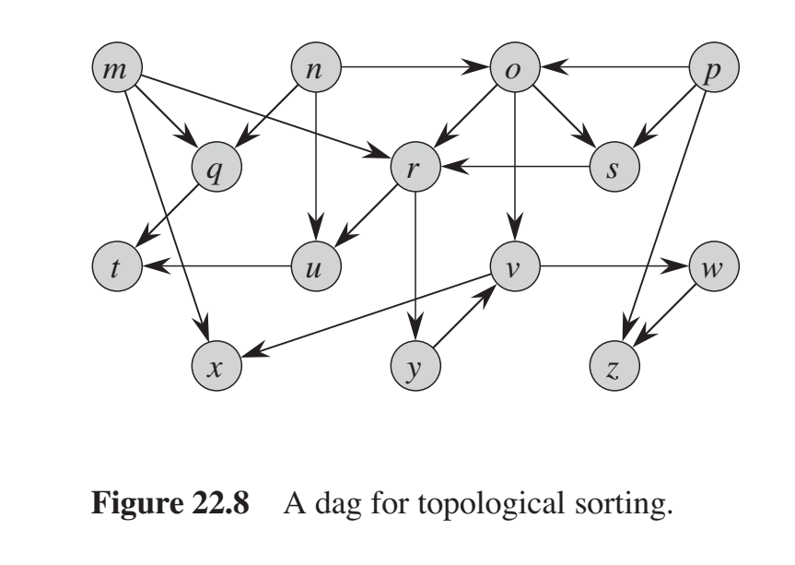
Practice
Source

Slide 36
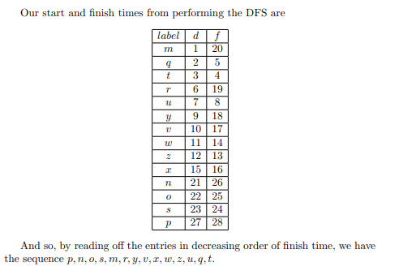
Solution

Slide 37
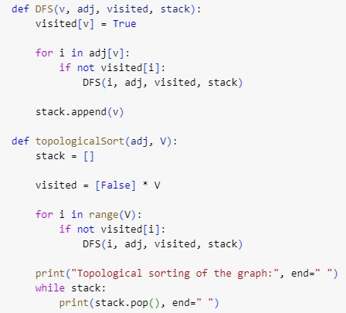
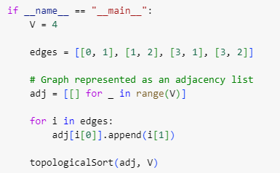
Code

Slide 38
Time Complexity
Linear: O(V+E)

